Slide 1


Sales Insights - Data Analysis Project using Tableau
By – Nikita Joshi
https://github.com/NIKITAJOSHI2
https://www.linkedin.com/in/nikitajoshi22/

Slide 2
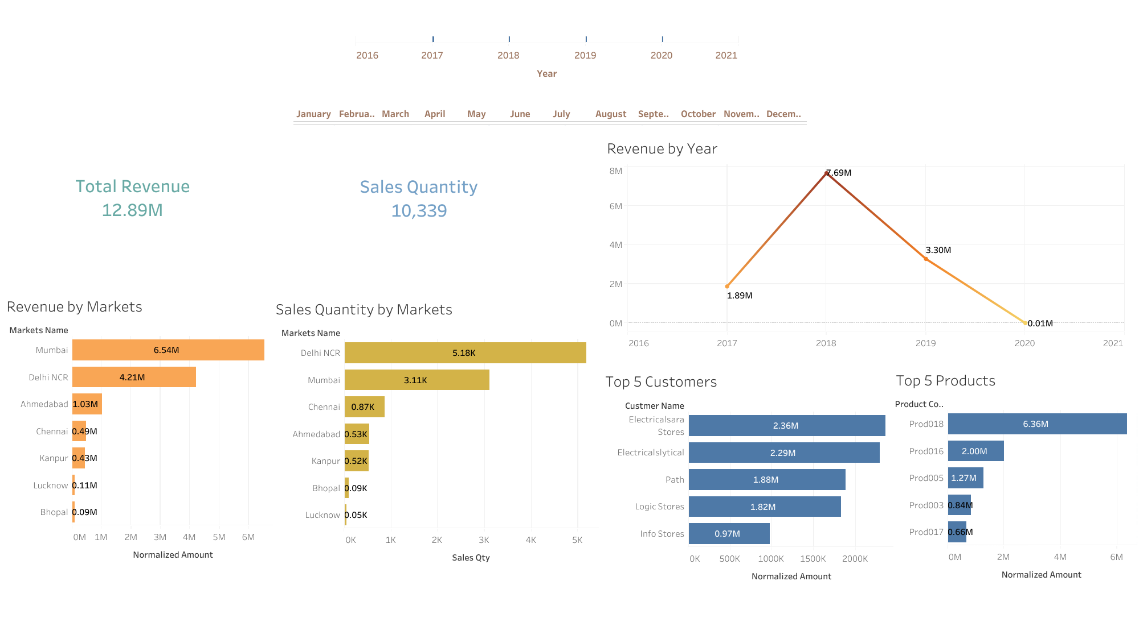

Slide 3
